Slide 1




FINAL CAPSTONE PRESENTATION
Medicaid Waiver and iBudget Onboarding for New Employees
EME 4684
LDT CAPSTONE
Waqas Saleem
EME 4684 – LDT Capstone
University of North Florida
July 2026

Slide 2


The Design Problem and Target Audience
New employees at The Arc Jacksonville receive complicated information about APD services, Medicaid Waivers, and iBudget Florida. Unfamiliar terminology and the amount of information can make the onboarding process overwhelming.
Target audience:
-New employees at The Arc Jacksonville
-Staff learning about disability services
-Employees who need clear, step-by-step guidance”

Slide 3

What the Needs Analysis Revealed
My needs analysis identified four major challenges:
New Employees receive too much information at once.
Medicaid terminology is difficult to understand.
Application steps are not always presented clearly.
New Employees need a simple checklist and reliable support resources.
- Create a brief, accessible onboarding guidelines

Slide 4

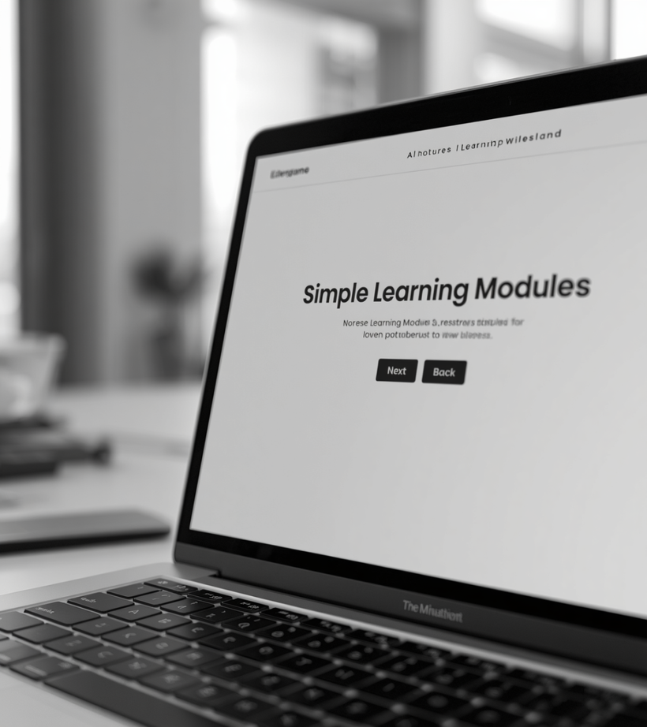
From Research to Final Design
I followed an iterative instructional design process:
Identified the learning and performance need
Researched Medicaid Waivers and iBudget Florida
Created a storyboard and initial prototype
Collected feedback from my mentor
Revised the content, navigation, and visuals

Slide 5
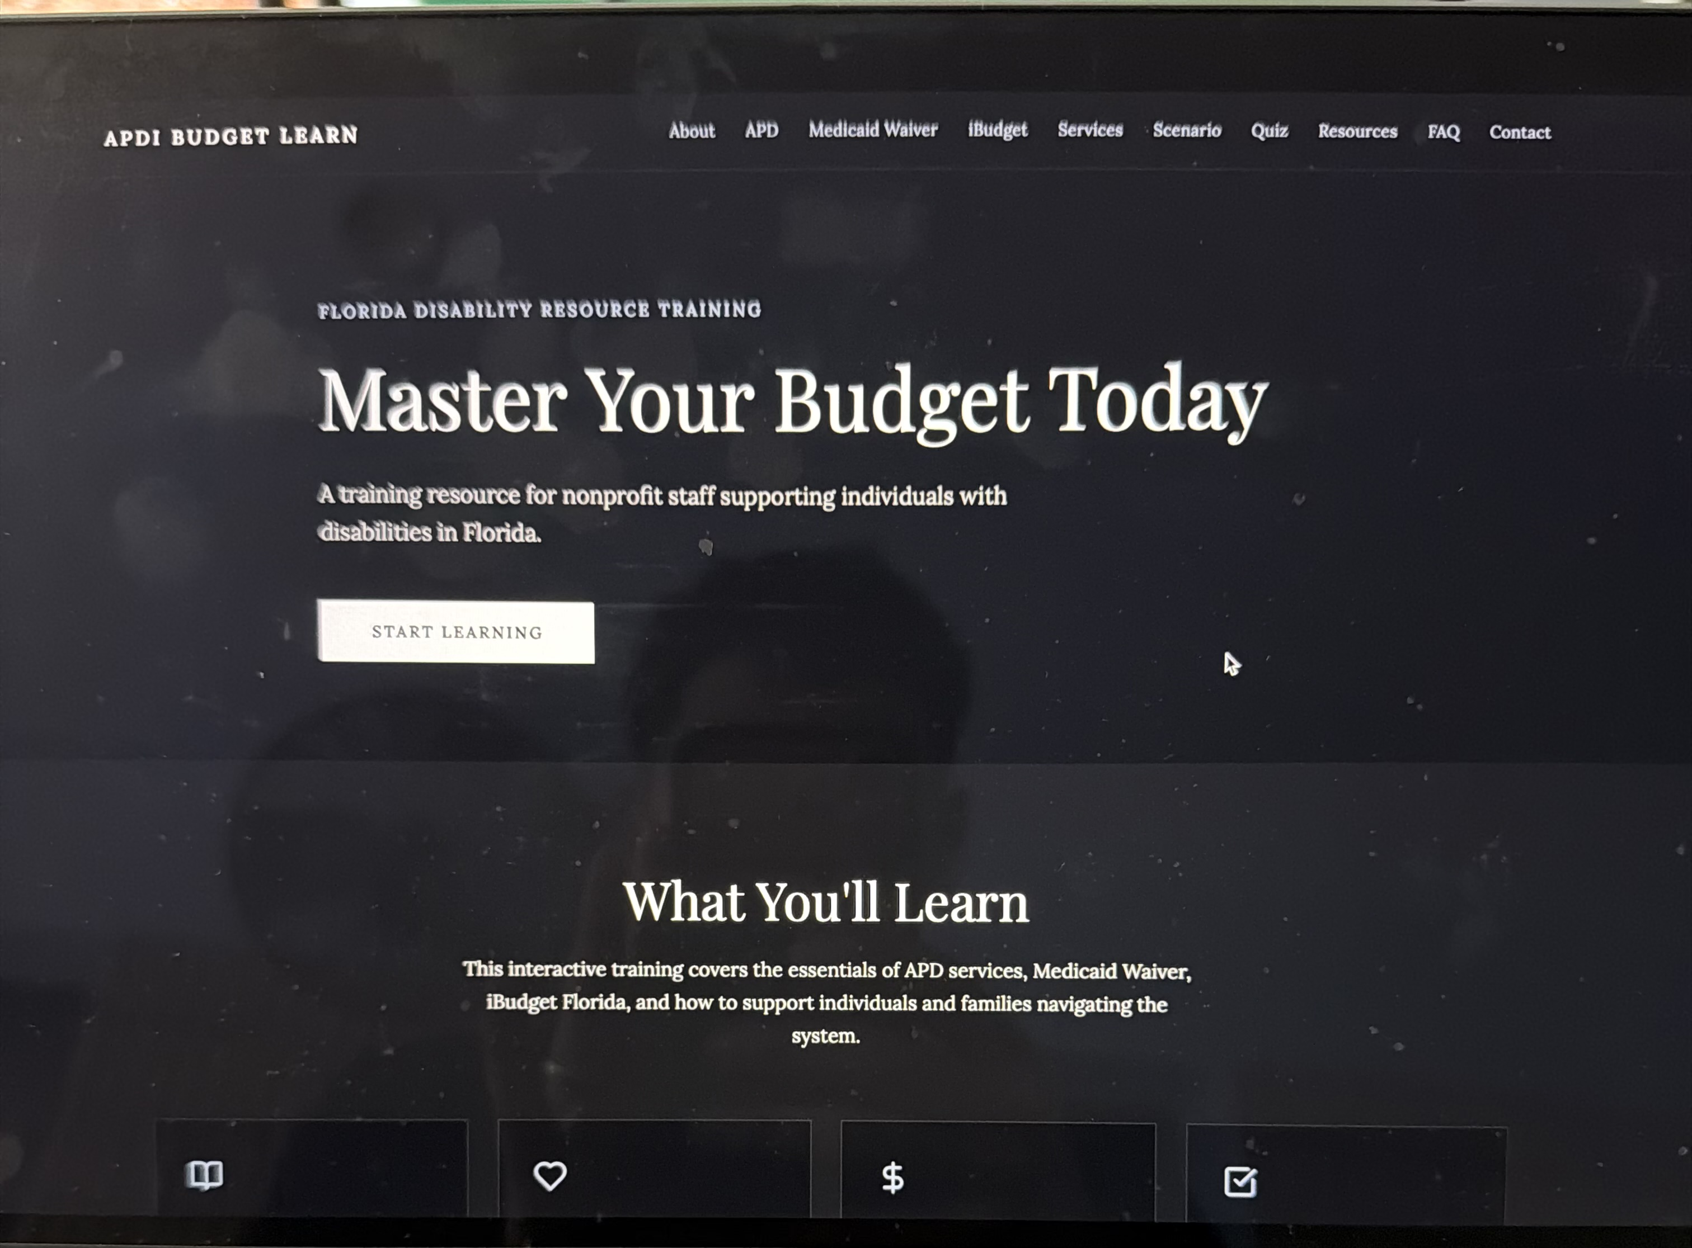
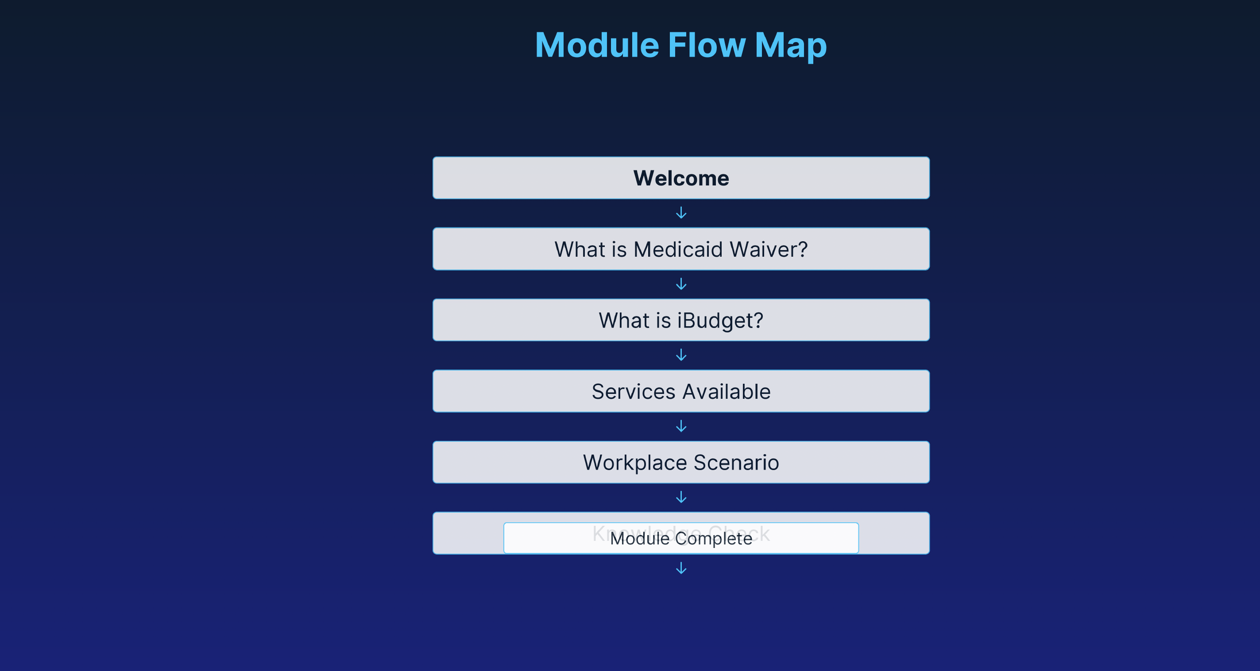
Turning the Idea Into a Prototype
Early Prototype
Initial Story Board
.

Slide 6
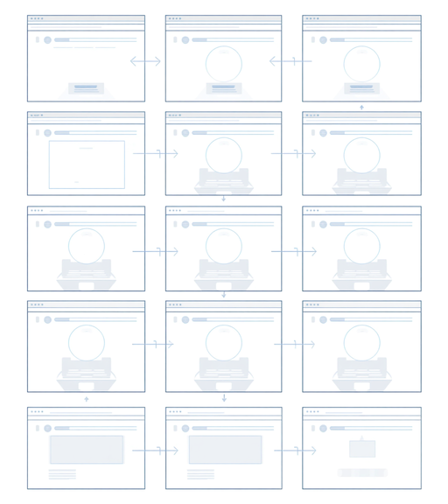
Mentor Feedback Improved My Design
My field experience at The Arc Jacksonville influenced the project.
Scott Holt, Vice President of Finance, explained that new employees often feel overwhelmed during onboarding.
His recommendations:
-Add a simple checklist.
-Use clear headings and visuals.
-Keep the information brief.
-Organize the content step by step.
Revisions made:
I simplified the language, shortened the content, added visual guidance, and improved the organization.

Slide 7
The Final Onboarding Guide
The final product provides families with:
A simple introduction to Medicaid Waivers and iBudget Florida
Clear, manageable sections
-A step-by-step application checklist
-An interactive decision-making activity
-Reliable support resources and next steps
Design priorities:
Clear language • Accessibility • Simple navigation • Family support
Add a large screenshot of the opening screen or main menu of your final module

Slide 8
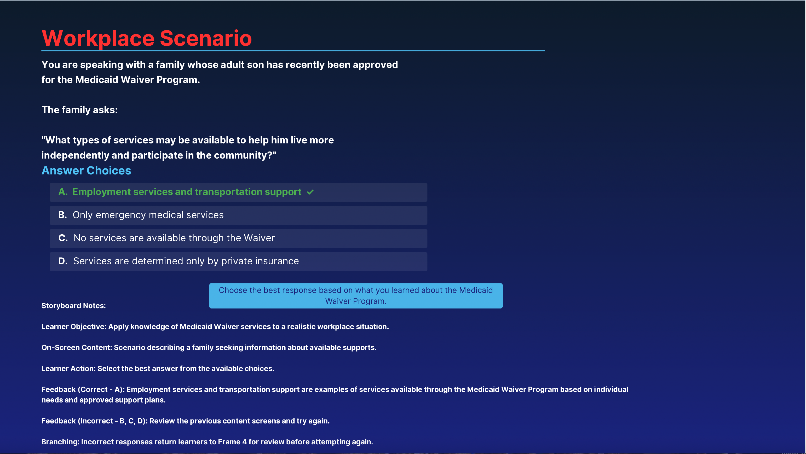
Demonstrating the Final Module

Slide 9
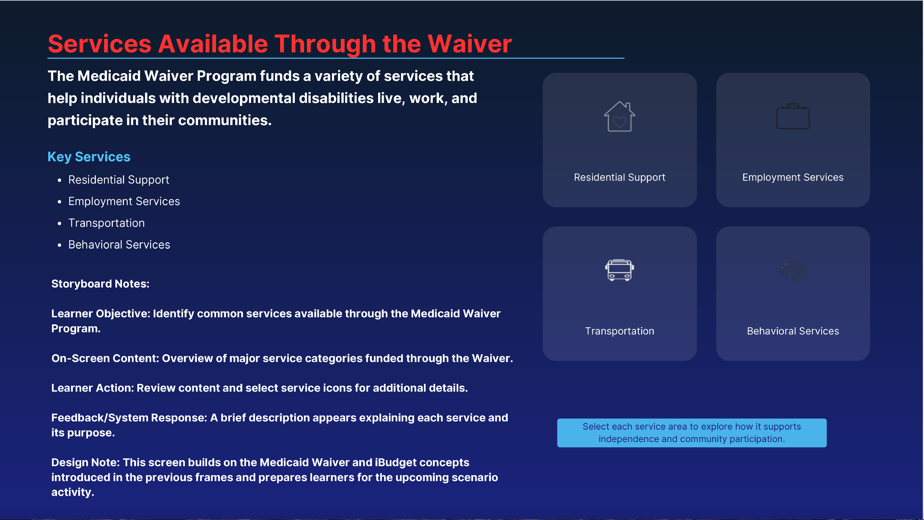

Slide 10
What I Learned and What I Would Change
What I learned:
Instructional design begins with understanding the learner’s needs.
Clear organization can make complicated information easier to understand.
Feedback and revision are essential parts of the design process.
Accessibility should be considered from the beginning.
What I would do differently:
With more time, I would test the module with several new employees and caregivers, collect their feedback, and improve the guide based on their experiences.

Slide 11
Clear Information Creates Confident Next Steps
This capstone project helped me transform complicated information into a clear and supportive learning experience.
The final guide:
-Responds to a real need identified through field experience
-Uses mentor feedback and an iterative design process
-Helps New employees understand their next steps
-Demonstrates my growth as an instructional designer
Thank you. Questions?

